Slide 1
CHAPTER 2
LIMITS AND CONTINUITY

Slide 2
CONTENTS
2.1. The Tangent & Velocity Problems
2.2. The Limit of a Function
2.3. Calculating Limits using the Limit Law
2.4. Continuity
2.5. Limits involving Infinity

Slide 3
2.3. CALCULATING LIMITS USING LIMIT LAWS
2.3.1. The Limit Laws
2.3.2. Limits and One-sided Limits
2.3.3 The Squeeze Theorem

Slide 4
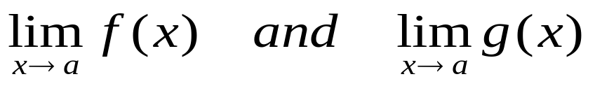
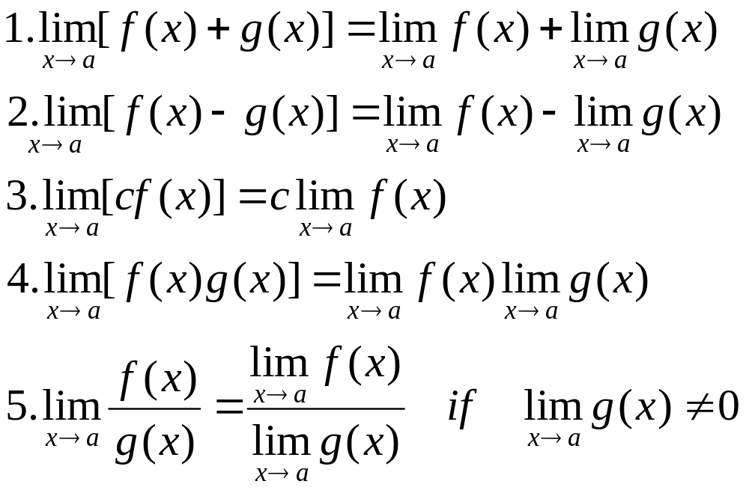
2.3.1 The Limit Laws
Limit Laws. Suppose that c is a constant and exist. Then

Slide 5
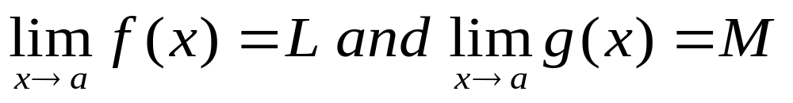
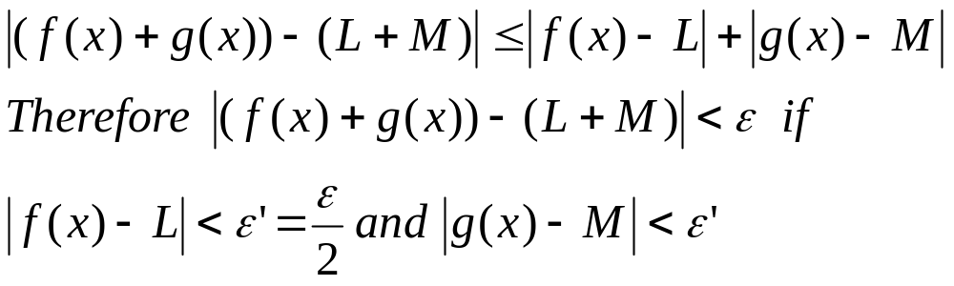
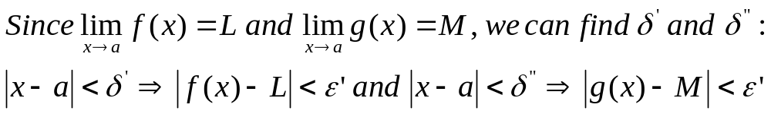
Proof of Law 1. Let for ε>0 we have
Let δ = min{δ’, δ”}. Then

Slide 6
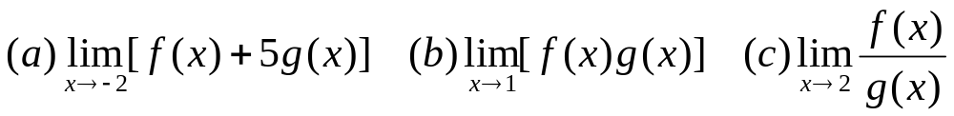
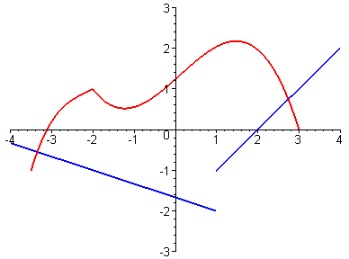
Example. Evaluate the following limits if they exist
y=f(x)
y=g(x)

Slide 7
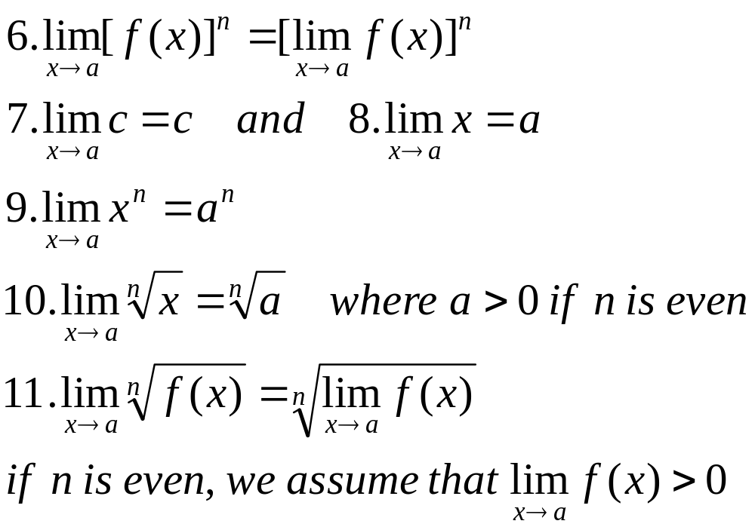
Corollory. Let f(x) be any function, n a positive interger, a and c be arbitrary real numbers. Then

Slide 8
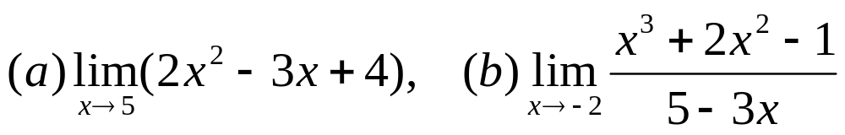
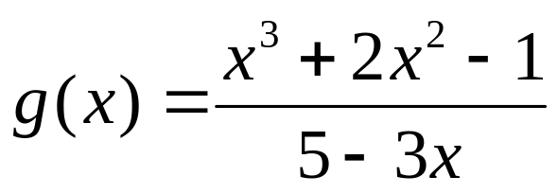
Example. Evaluate the following limits and justify each step
Solution. ???
Note. Let f(x) = 2x² – 3x + 4 and
Then the limits are precisely 39 = f(5) and –1/11 = g(–2).
This is true because f(x) is a polynomial and g(x) is a rational function as indicated by the following Property

Slide 9
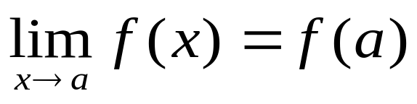
Direct Substitution Property. If f is a polynomial or a rational function and a is in the domain of f, then
Functions satisfying the above property are called continuous functions. They will be studied in the next section.
Note finally that not all functions are continuous.
We cannot apply the Direct Substitution Property for discontinuous functions

Slide 10
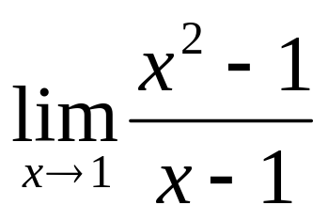
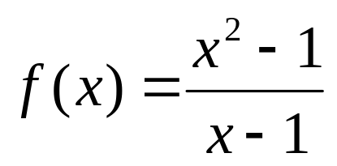
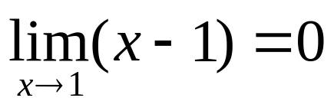
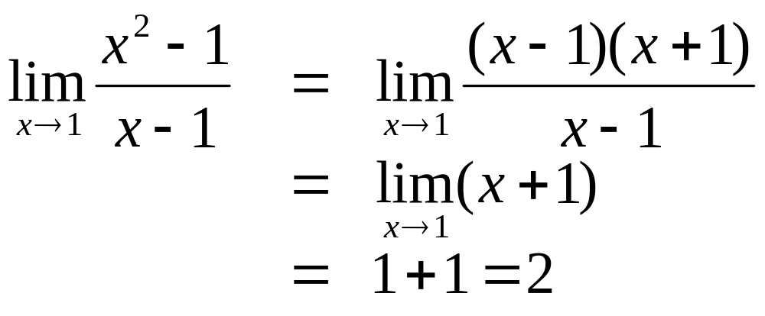
Example. Find
Solution. We cannot apply the DS Property since the function is not defined at x=1.
Neither can we apply the Quotient Law because
However, as x approaches 1 and x ≠ 1, we have

Slide 11
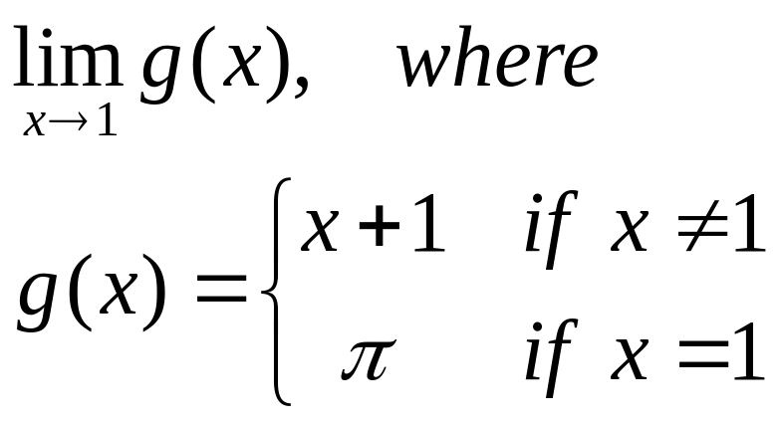
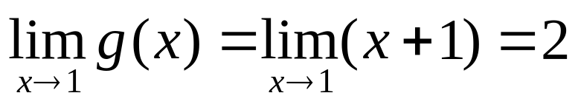
Example. Find
Solution. The function g(x) is defined at x = 1, but not continuous at x=1. However as x approaches 1, x ≠ 1, we have

Slide 12
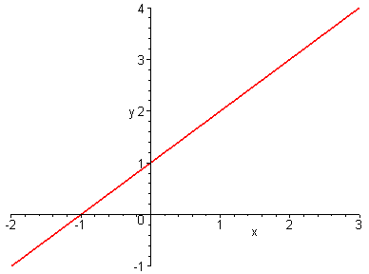
Note that the graphs of g(x) and f(x) = x + 1 are the same except at the points x = 1.

Slide 13
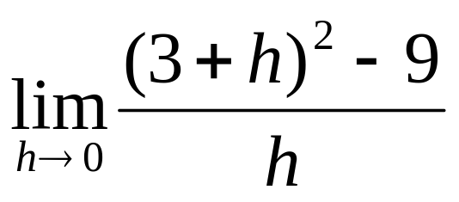
Example. Evaluate
Solution. ???

Slide 14
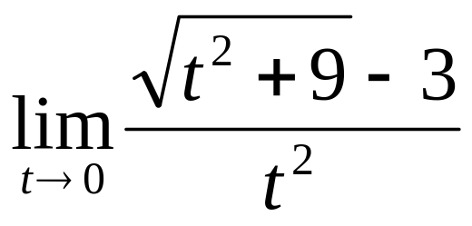
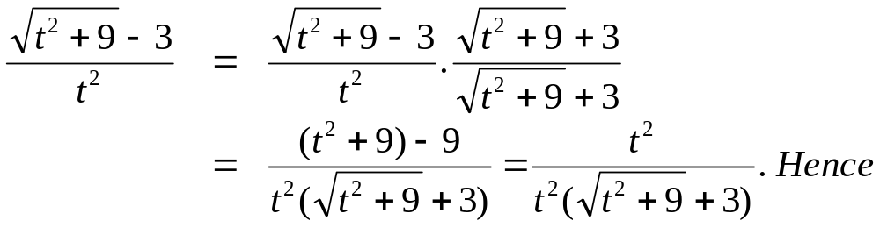
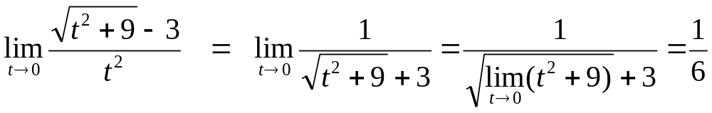
Example. Find
Solution. The limits of both numerator and denominator are null. First we have to rationalize the numerator

Slide 15
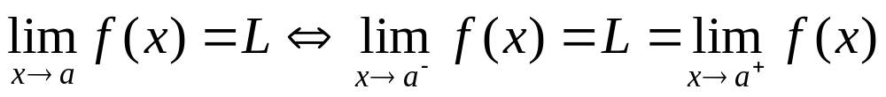
2.3.2 Limits and One-sided Limits
For some problems, it is convenient to compute the one-sided limits first and then use
Theorem 1
It should be noted that Limit Laws also hold for one-sided limits.

Slide 16
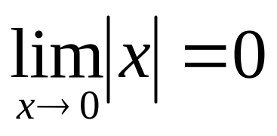
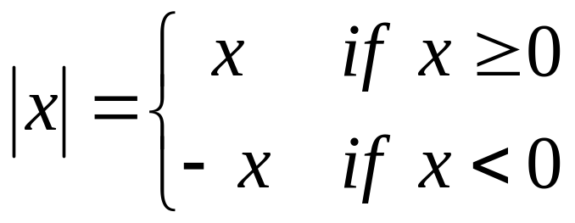
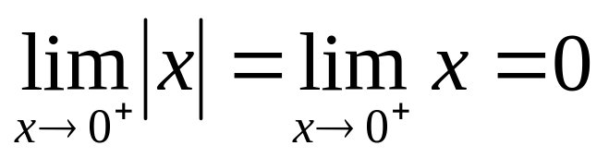
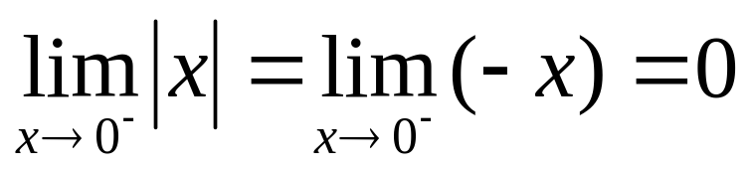
Example. Show that
Solution. Recall that
For x>0 we have
For x<0 we have
Hence by Theorem 1

Slide 17
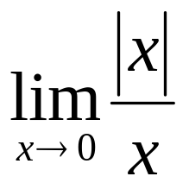
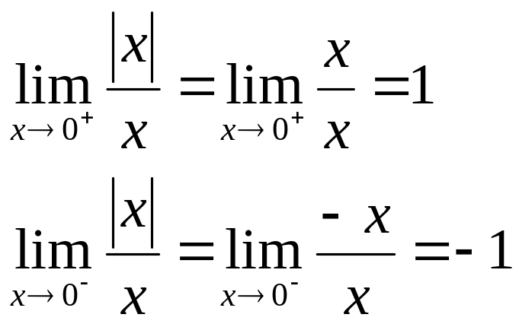
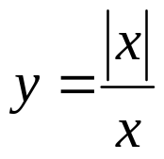
Example. Prove that does not exist
Solution.
Since the right-and left-hand limits are different, does not exist
y
1
0
x
-1

Slide 18
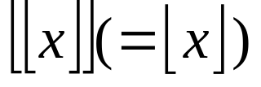
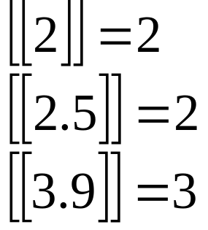
Definition. The greatest integer function, denoted by , is defined as the largest integer ≤ x
Example. we have

Slide 19
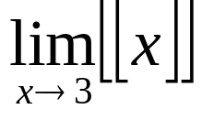
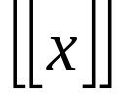
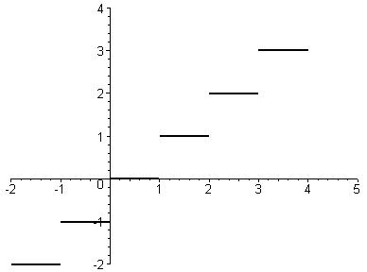
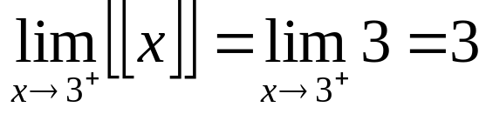
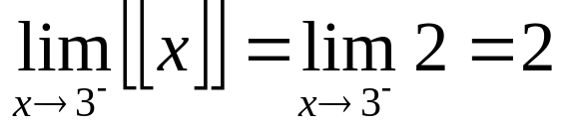
Example. Show that does not exist
Solution. is a step function corresponding to the following graph
For 3 ≤ x < 4 we have
For 2 ≤ x < 3 we have
Hence does not exist

Slide 20
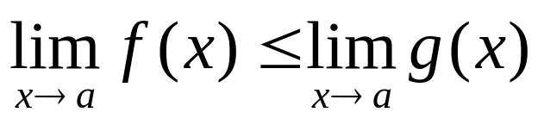
2.3.3 The Squeeze Theorem
Theorem 2. If f(x) ≤ g(x) when x is near a (except possibly when x = a) and the limits of f(x) and g(x) exist as x approaches a, then

Slide 21
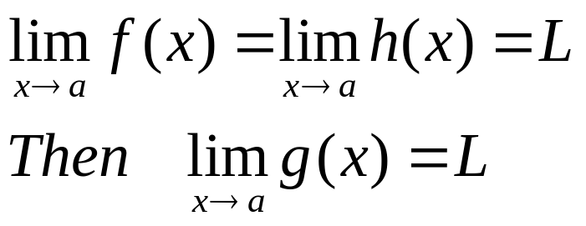
The Squeeze Theorem. If f(x) ≤ g(x) ≤ h(x) when x is near a (except possibly when x = a) and
h
The Squeeze Theorem is also called the Sandwich Theorem
L
g
f
a

Slide 22
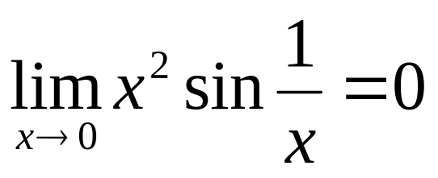
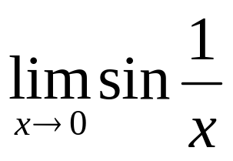
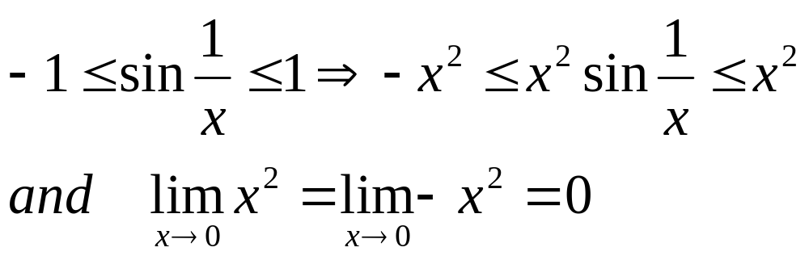
Example. Show that
Solution. Note that we cannot apply the Product Law because does not exist.
However we have
Therefore the Squeeze Theorem gives

Slide 23
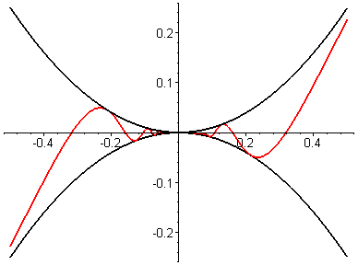
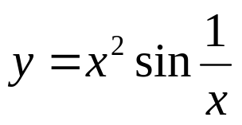
MAPLE command >limit(x^2*sin(1/x),x=0);
also gives the result 0
y=x²
y=–x ²

